Slide 1
JAVA Lecture 12
Interfaces

Slide 2
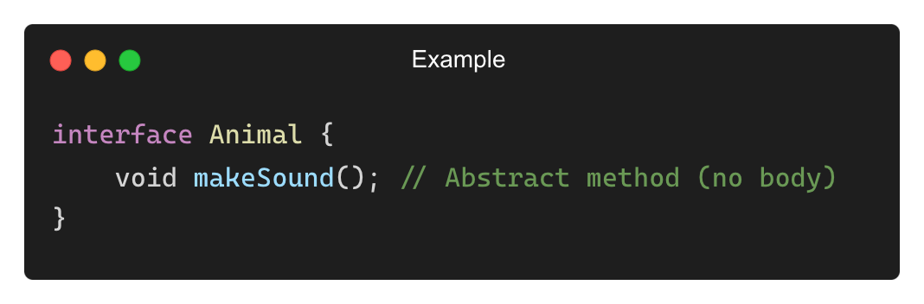
What is an Interface in Java?
An interface is a blueprint for a class that defines a set of abstract methods.
It provides complete abstraction—a class implementing an interface must provide concrete implementations.
Key Features:
✅ Defines only method signatures (until Java 8)
✅ Cannot contain constructors (since no object creation)
✅ Supports multiple inheritance
✅ All methods are public and abstract by default

Slide 3
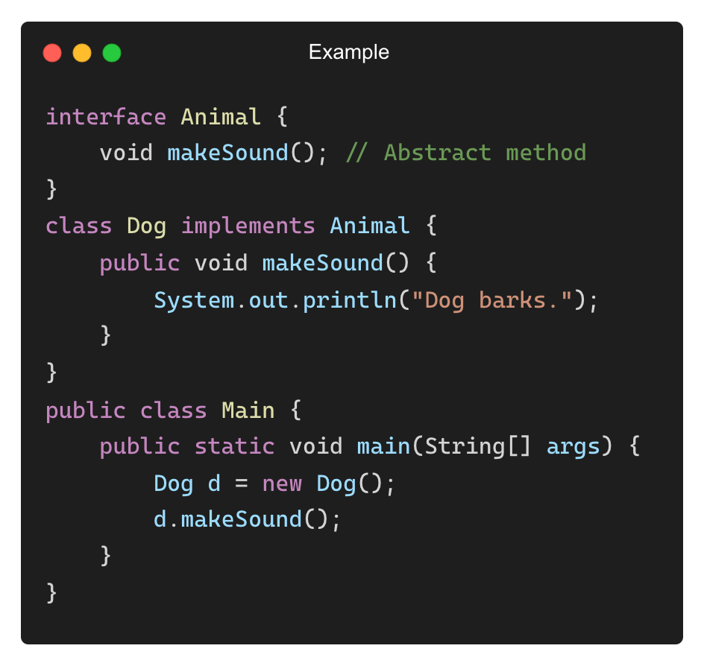
Implementing an Interface
Interfaces must be implemented by a class using the implements keyword.
Output:
Dog barks.

Slide 4
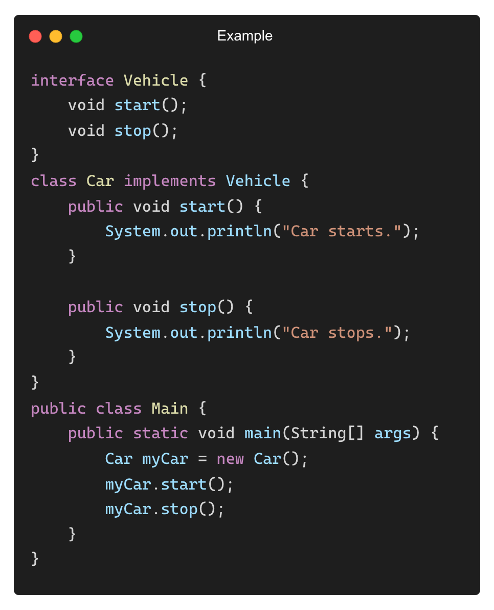
Interface with Multiple Methods
A class must implement all interface methods unless it is abstract.
Output:
Car starts.
Car stops.

Slide 5
Why Use Interfaces?
Supports Multiple Inheritance: Java does not allow multiple inheritance with classes, but interfaces make it possible.
Encapsulation of Behavior: Interfaces define behavior without dictating implementation.
Loose Coupling: Code is more flexible since implementations can be changed easily.
Code Standardization: Ensures that different classes follow the same structure.
Example: Multiple Devices Using the Same Interface
Device (Interface) → Mobile, Laptop, Tablet

Slide 6
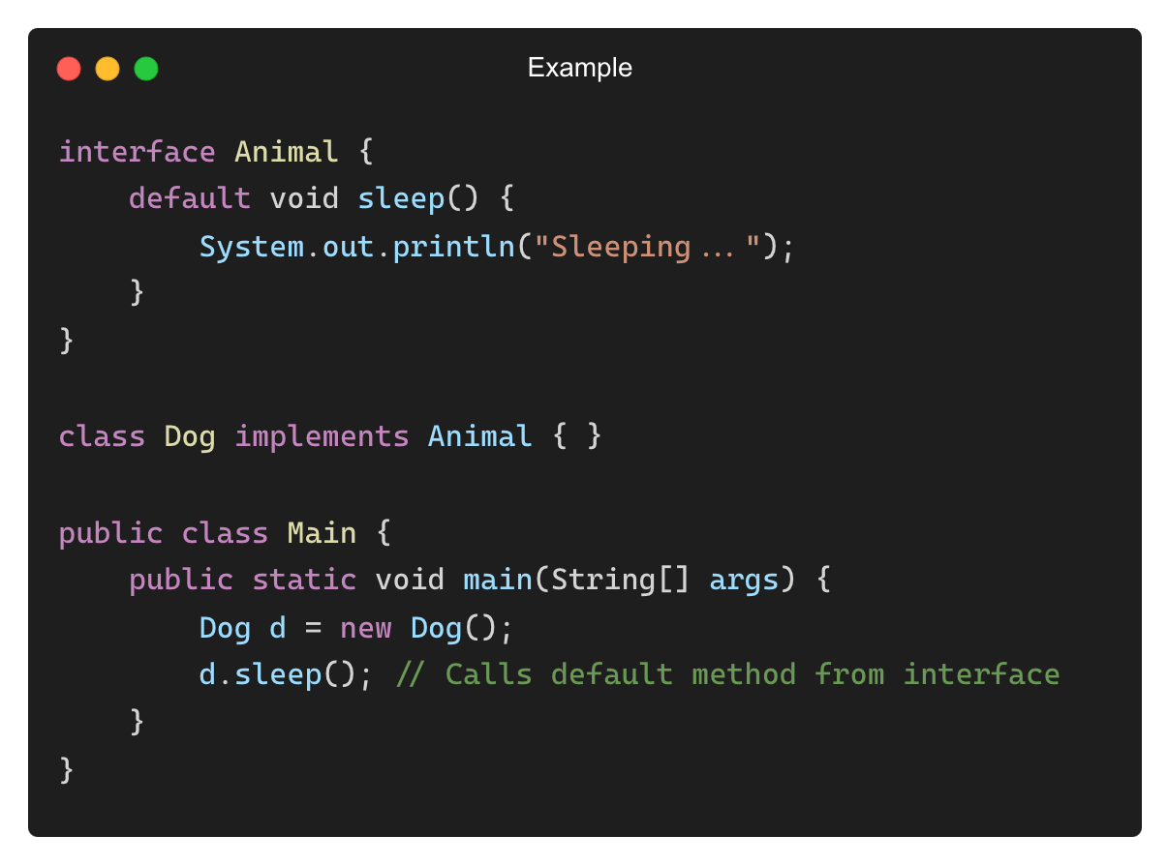
Default and Static Methods in Interfaces
Java 8 introduced default and static methods in interfaces.
Default Method: A method with a body inside an interface.

Slide 7
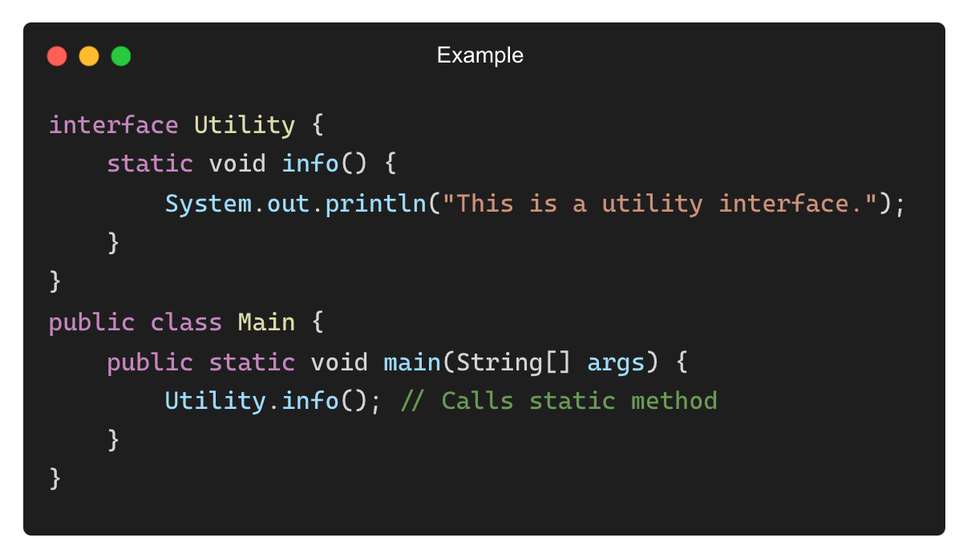
Default and Static Methods in Interfaces (Contd.)
Static Method:
Output:
This is a utility interface.

Slide 8
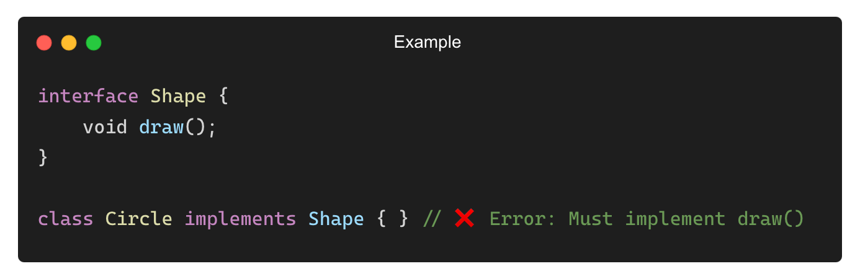
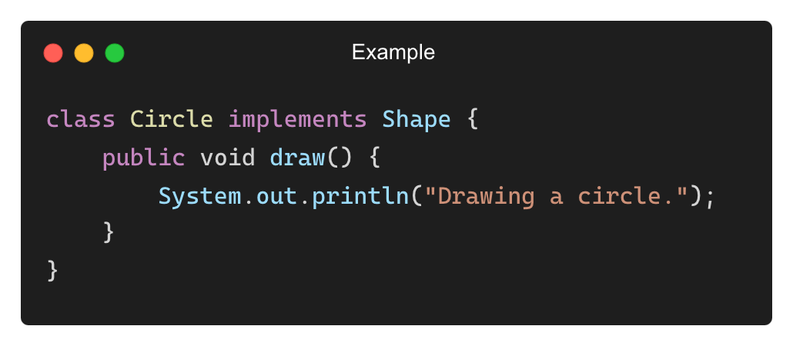
Common Mistakes with Interfaces
❌ Forgetting to Implement All Methods in a Class
✅ Solution: Implement all interface methods.

Slide 9
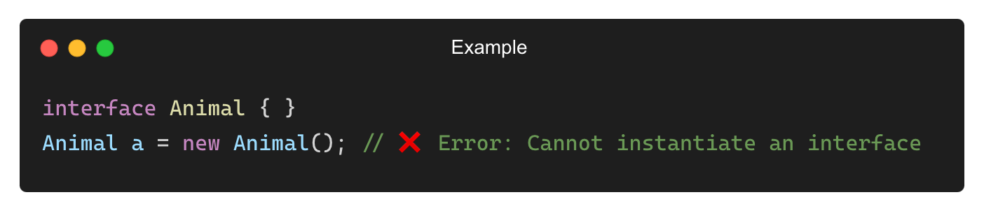
Common Mistakes with Interfaces (Contd.)
❌ Trying to Create an Object of an Interface
✅ Solution: Use a class that implements the interface.

Slide 10
When to Use Interfaces?
✅ Use an Interface When:
You want to define a common behavior that multiple classes should implement.
You need multiple inheritance support in Java.
You want to create a loosely coupled system.
✅ Use Abstract Classes When:
You need partial implementation (some methods implemented, some abstract).
You require constructors, instance variables, or concrete methods.
Example: Drivable (Interface) → Implemented by Car, Bike, Bus

Slide 11
Why Use Multiple Interfaces?
Java does not support multiple inheritance with classes, but interfaces allow a class to implement multiple behaviours.
Benefits:
✅ Encourages modularity and flexibility.
✅ Allows different functionalities to be combined in a class.
✅ Supports loose coupling.
Example Use Case:
Flyable (Interface) → Bird, Airplane
Swimmable (Interface) → Fish, Duck

Slide 12
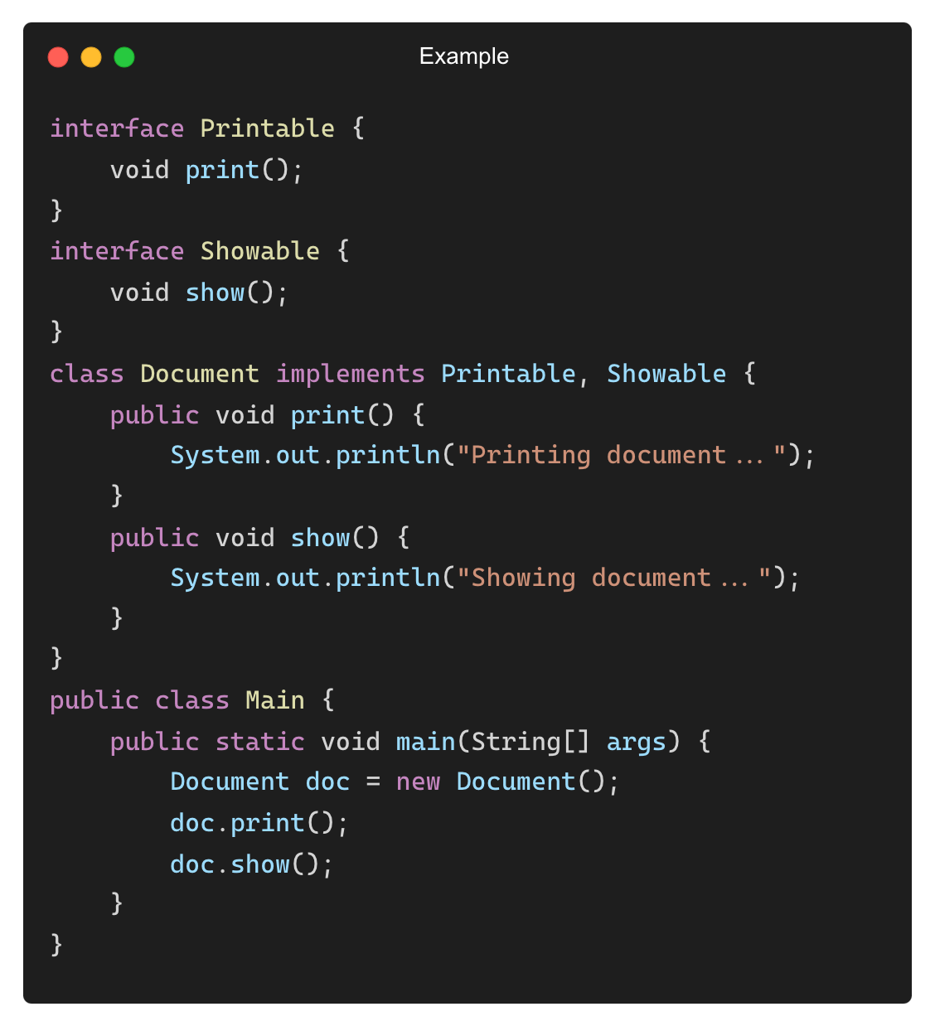
Implementing Multiple Interfaces (Syntax)
A class can implement multiple interfaces using a comma-separated list.
Output:
Printing document...
Showing document...

Slide 13
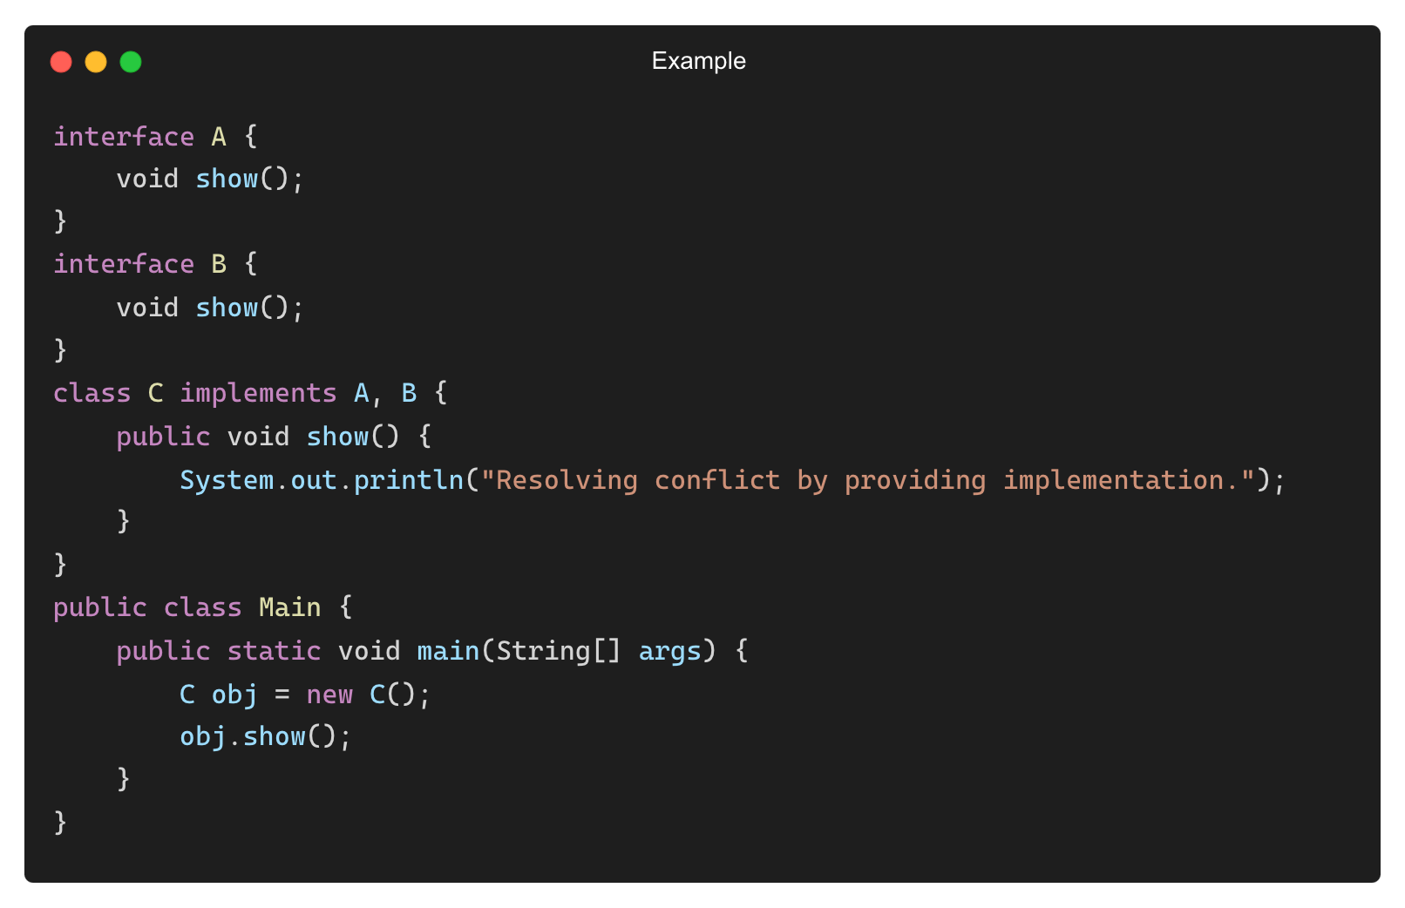
Resolving Conflicts When Two Interfaces Have the Same Method
Output:
Resolving conflict by providing implementation.

Slide 14
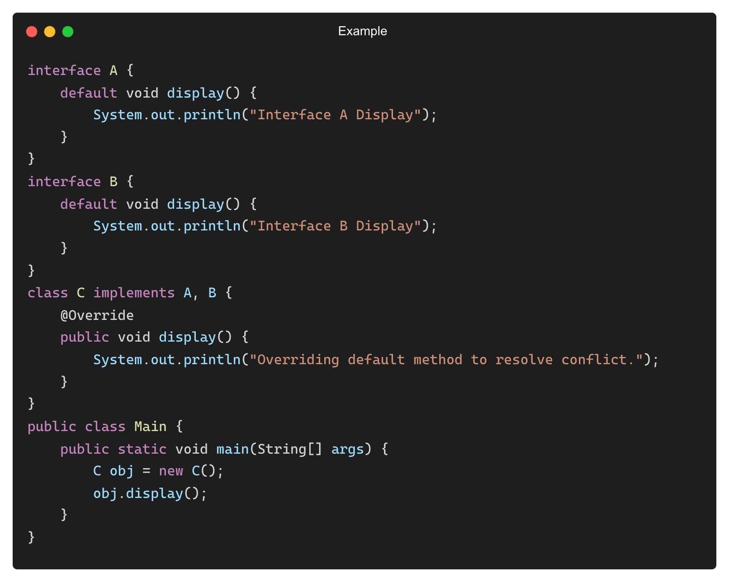
Default Methods in Multiple Interfaces (Java 8+)
If two interfaces have the same default method, the implementing class must override it.
Output:
Overriding default method to resolve conflict.

Slide 15
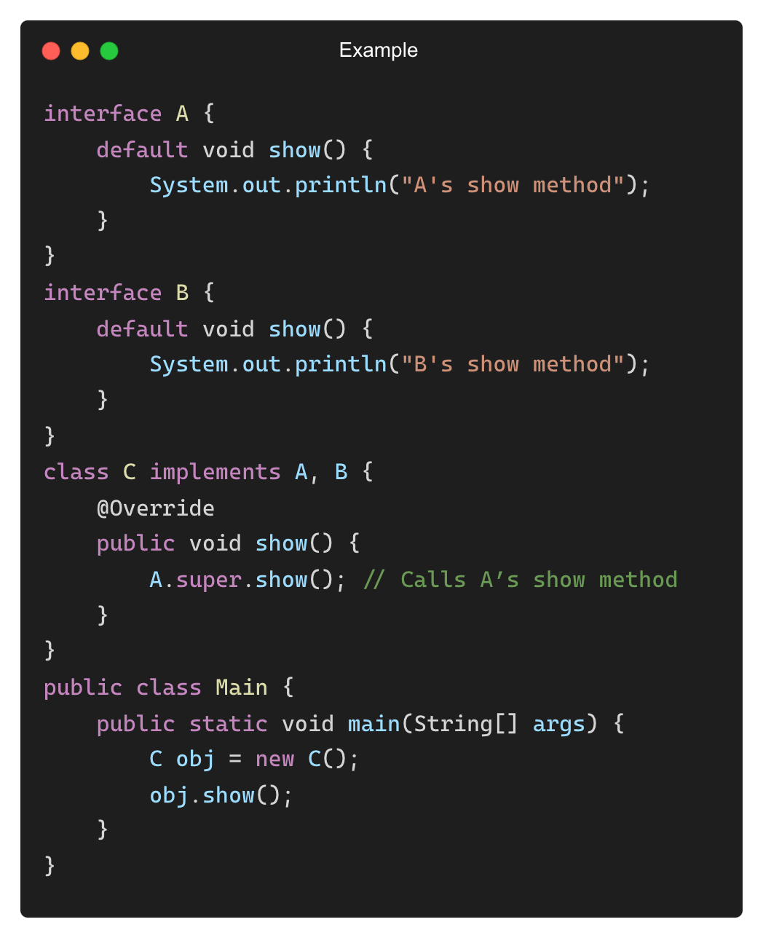
Using super to Call Default Methods from Interfaces
If required, super can be used to call a specific interface’s default method.
Output:
A's show method

Slide 16
Multiple Interfaces vs. Multiple Inheritance in C++
Feature | Multiple Interfaces (Java) | Multiple Inheritance (C++)
Supported? | ✅ Yes | ✅ Yes
Resolves Ambiguity? | ✅ Yes (Single Implementation required) | ❌ No (Diamond problem)
Implements Behaviour? | ✅ Yes | ✅ Yes
Inherits Properties? | ❌ No | ✅ Yes
• Why Java Uses Interfaces Instead of Multiple Inheritance?
✅ Avoids ambiguity (diamond problem).
✅ Ensures better design by separating behaviours.

Slide 17
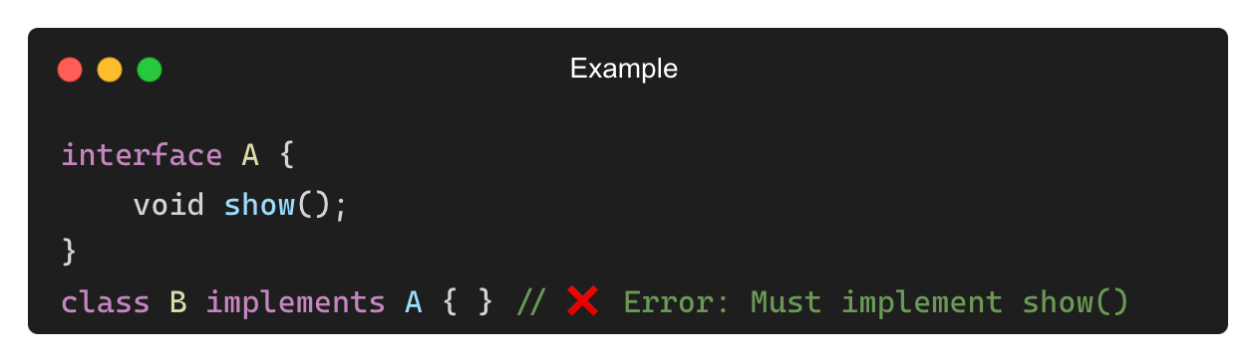
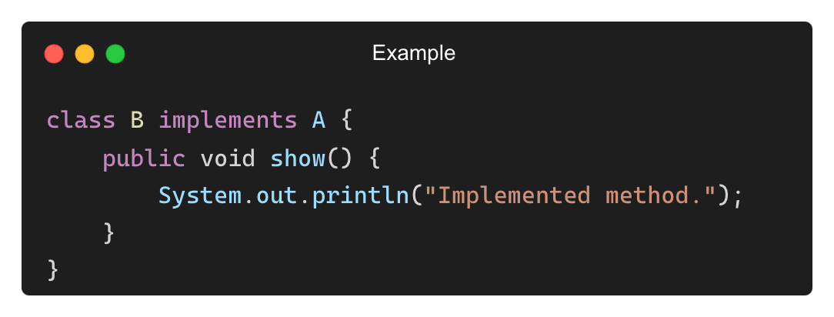
Common Mistakes with Multiple Interfaces
❌ Forgetting to Implement All Methods
✅ Solution: Implement the missing method.

Slide 18
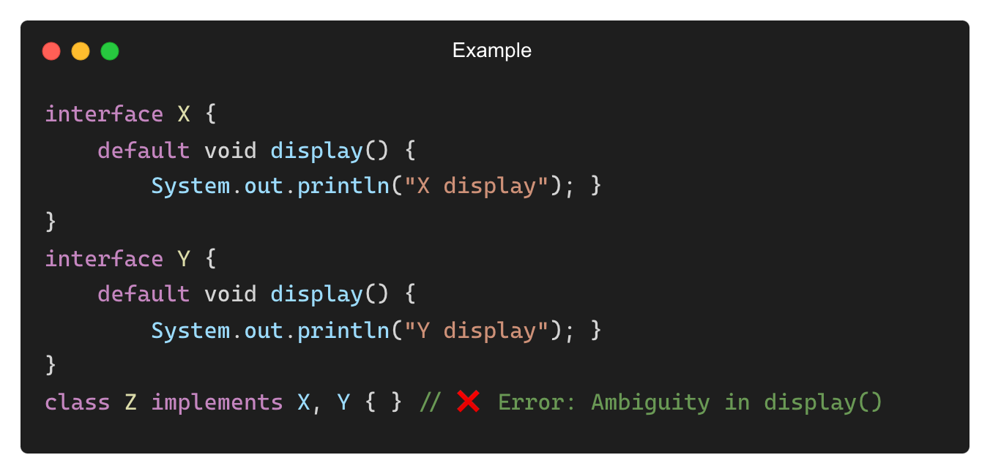
Common Mistakes with Multiple Interfaces (Contd.)
❌ Conflicts with Default Methods in Interfaces
✅ Solution: Override display() in class Z.

Slide 19
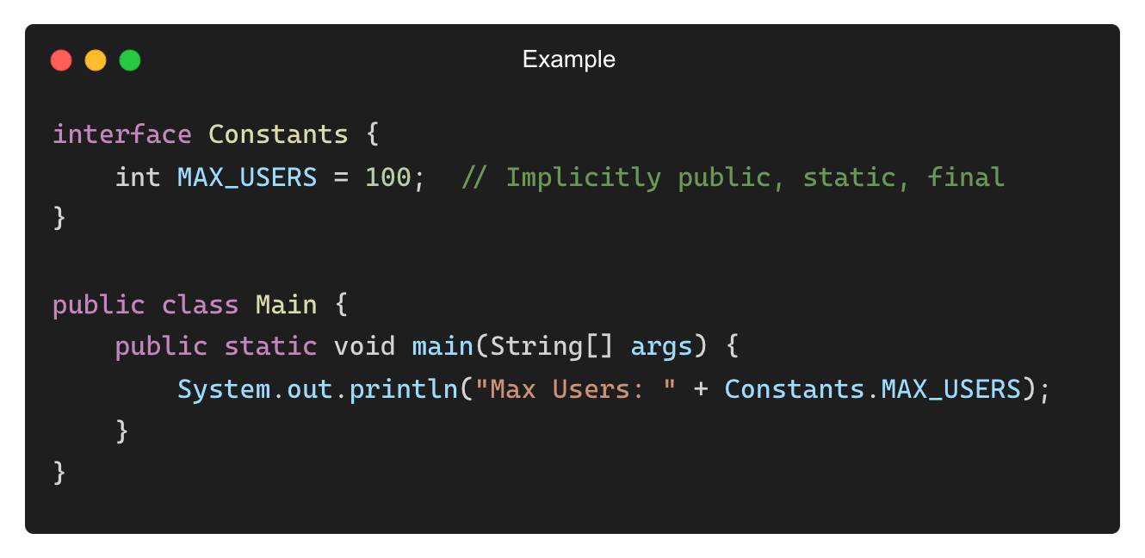
Are Variables Allowed in Interfaces?
Yes, but with restrictions!
Rules for Variables in Interfaces:
✅ All variables are implicitly public, static, and final.
✅ No instance variables (since interfaces cannot have state).
✅ Must be initialized when declared.
Output:
Max Users: 100

Slide 20
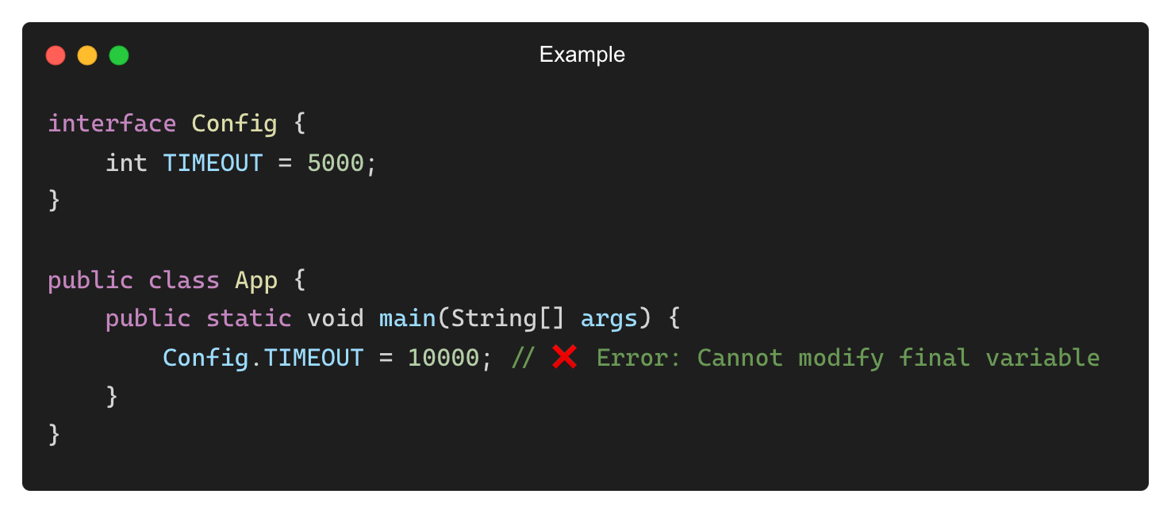
public static final Behavior in Interface Variables
Feature | Behavior in Interfaces
Public | Accessible everywhere
Static | Belongs to the interface (not instances)
final | Cannot be modified after assignment
Compilation Error:
Cannot assign a value to final variable 'TIMEOUT'

Slide 21
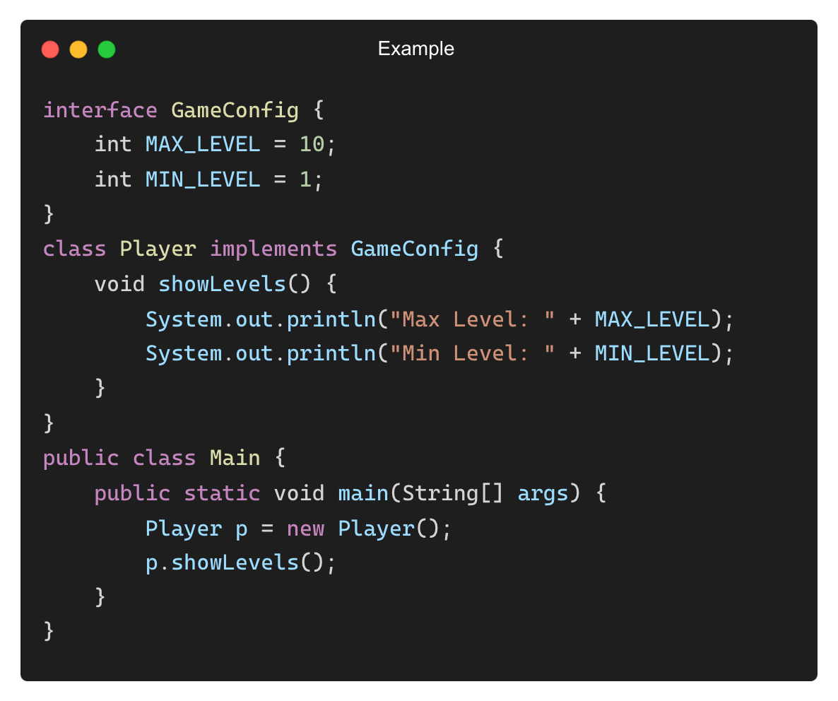
Using Interface Constants in Implementing Classes
Output:
Max Level: 10
Min Level: 1

Slide 22
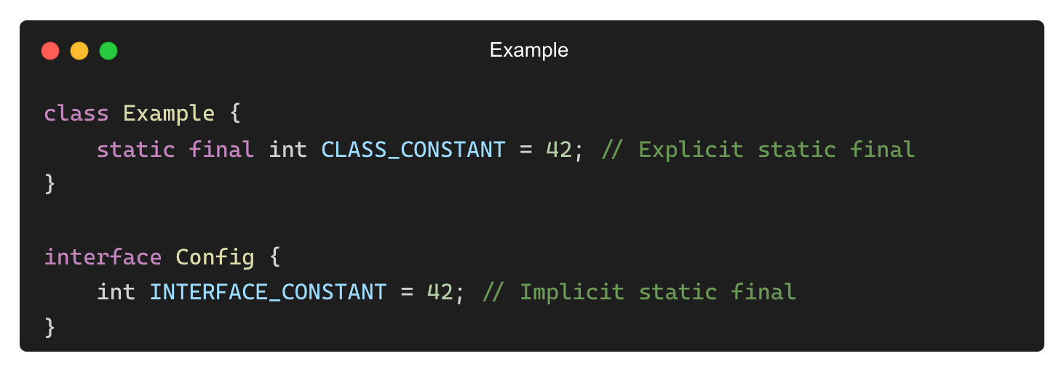
How Interface Constants Differ from Class Variables
Feature | Interface Constants | Class Variables
Declaration | public static final (default) | Can be any access level
Initialization | Required | Not required
Modification | Not allowed | Allowed (unless final)
Memory Usage | Stored in constant pool | Stored per object (unless static)
• Example (Class Variable vs. Interface Constant):

Slide 23
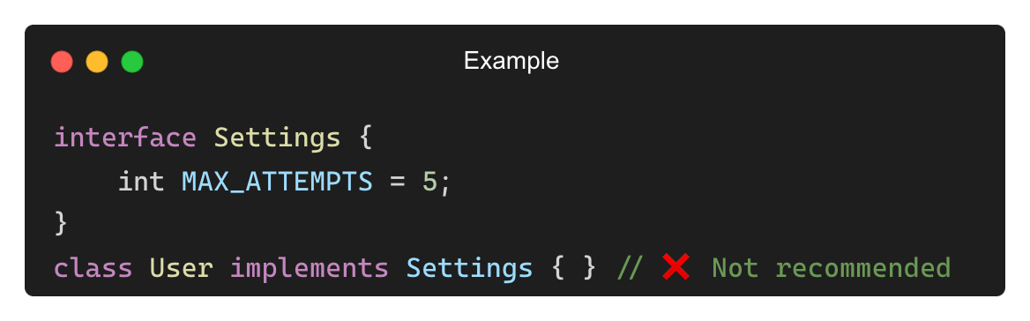
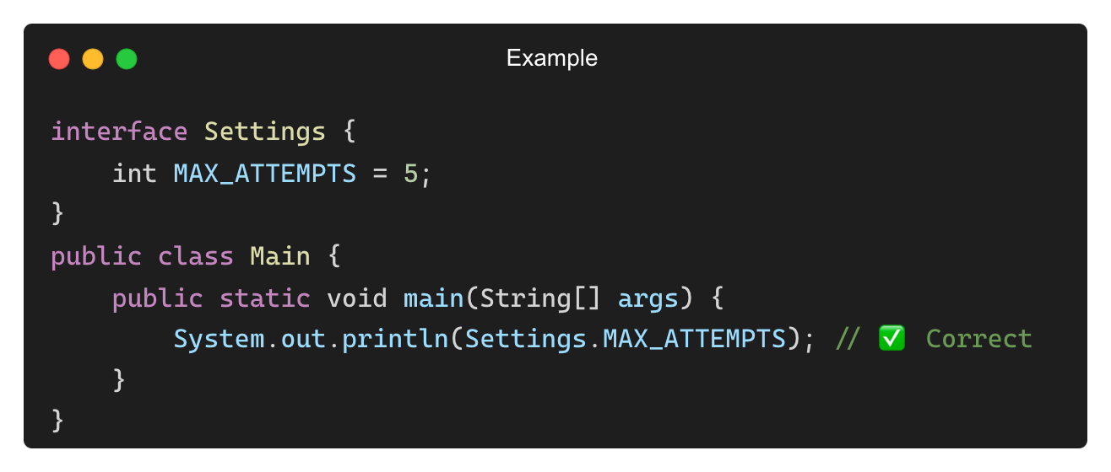
Best Practices for Using Interface Constants
✅ Use interface constants for shared configurations and settings.
✅ Use meaningful names in uppercase (e.g., MAX_USERS).
✅ Use class constants instead of interface constants where possible (to avoid unintended coupling).
• Bad Practice (Implementing an Interface Just for Constants):
• Better Approach (Use static Access Instead)

Slide 24
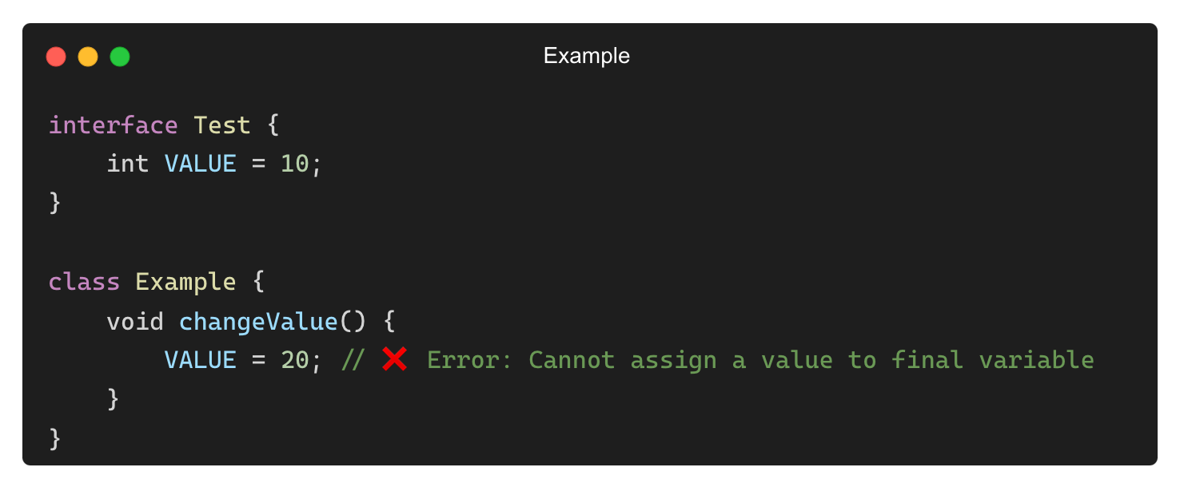
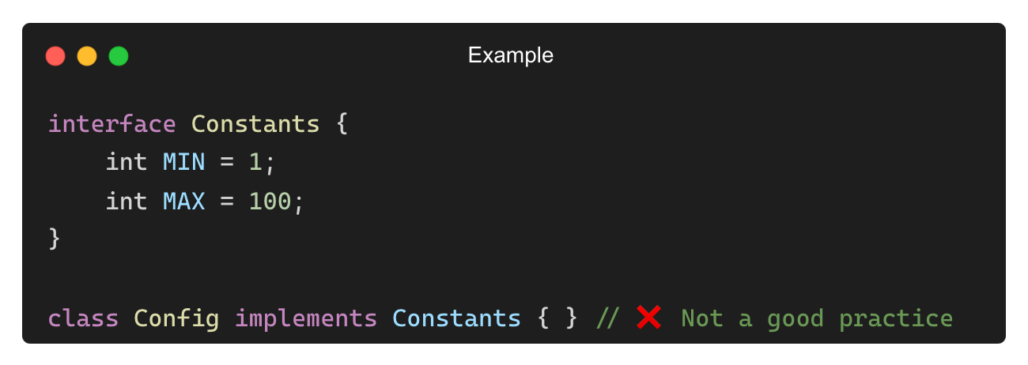
Common Mistakes with Interface Variables
❌ Trying to Modify an Interface Variable
✅ Solution: Define a new variable inside the class instead.
❌ Using an Interface Just to Store Constants (Anti-Pattern)
✅ Solution: Use a class with static final variables instead.

Slide 25
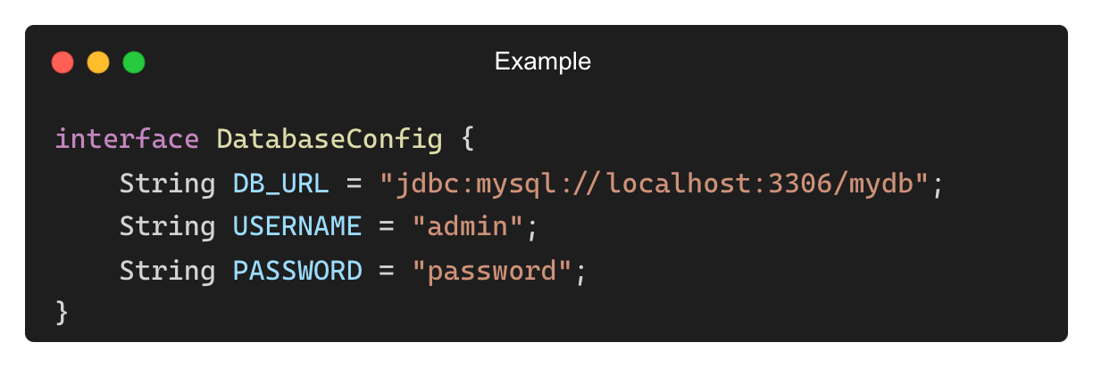
When to Use Interface Constants?
✅ Use Interface Constants When:
• Defining global constants that are truly related to the interface.
• Providing configuration values that apply to multiple implementing classes.
❌ Avoid Interface Constants When:
• The constants are not strongly related to the interface functionality.
• You are just using the interface as a global constant holder.

Slide 26
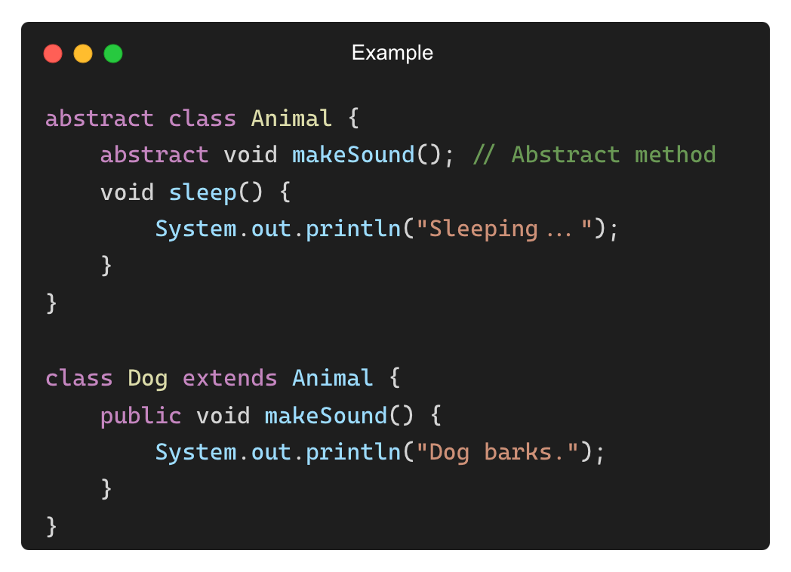
What is an Abstract Class?
A class that cannot be instantiated and may contain both abstract and concrete methods.
Provides partial abstraction—some methods can have implementation.
Key Features:
✅ Can have constructors
✅ Can contain instance variables
✅ Can have concrete (implemented) methods
✅ Supports single inheritance only

Slide 27
Key Differences Between Interfaces and Abstract Classes
Feature | Interface | Abstract Class
Abstraction Level | 100% (Until Java 8) | Partial (Can have concrete methods)
Method Implementation | Cannot have concrete methods (Before Java 8) | Can have both abstract and concrete methods.
Constructors | ❌ No constructors | ✅ Can have constructors
Variables | public static final (constants only) | Can have instance variables
Access Modifiers | All methods are public. | Methods can have private, protected, or public access.
Multiple Inheritance | ✅ Allowed | ❌ Not allowed
Use Case | Defines a contract that multiple classes must follow. | Defines a base class with some shared behavior.

Slide 28
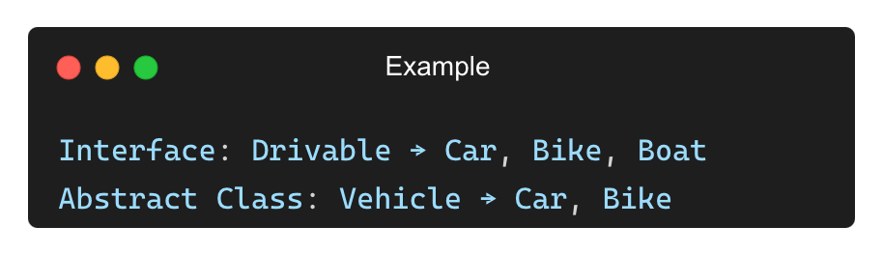
Choosing Between Interface and Abstract Class
✅ Use an Interface When:
• You need to define behavior that multiple unrelated classes should follow.
• You require multiple inheritance support.
• You want to define constants.
✅ Use an Abstract Class When:
• You need to partially implement some methods.
• You want to provide common fields for all subclasses.
• You expect subclasses to share code.

Slide 29
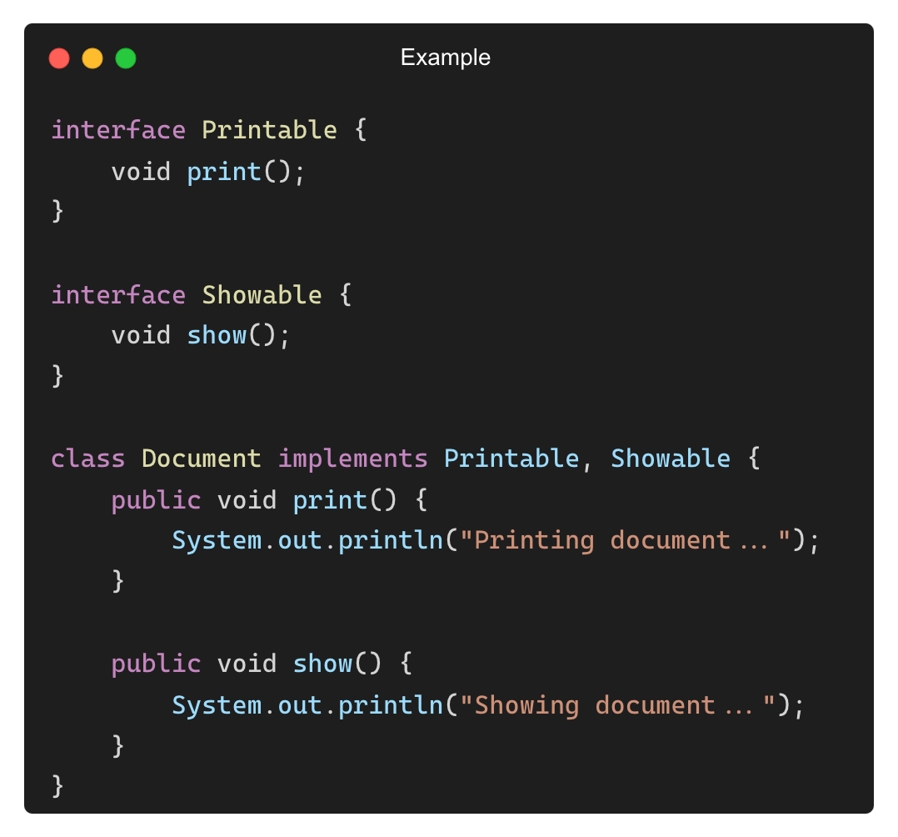
Multiple Inheritance with Interfaces (Java Limitation)
Java does not allow multiple inheritance of classes but allows multiple interfaces.

Slide 30
THANK YOU

